Slide 1
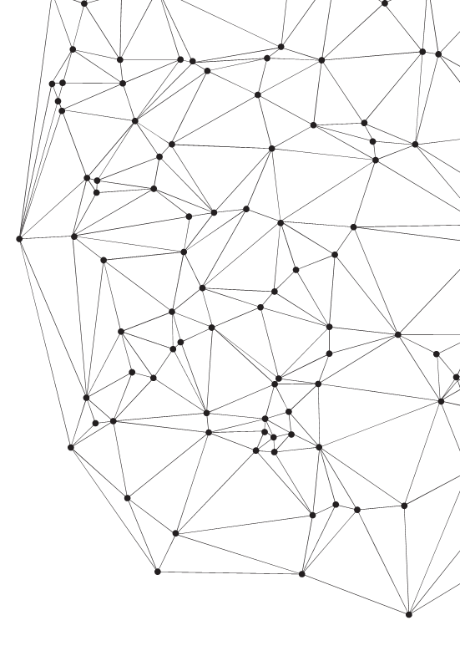
2019
Computer Simulation-Final Project
Prof. Steve Xia
Yuzhou Liu, Hang Xu, Qinghan Shen, Jiaren Ma

Slide 2
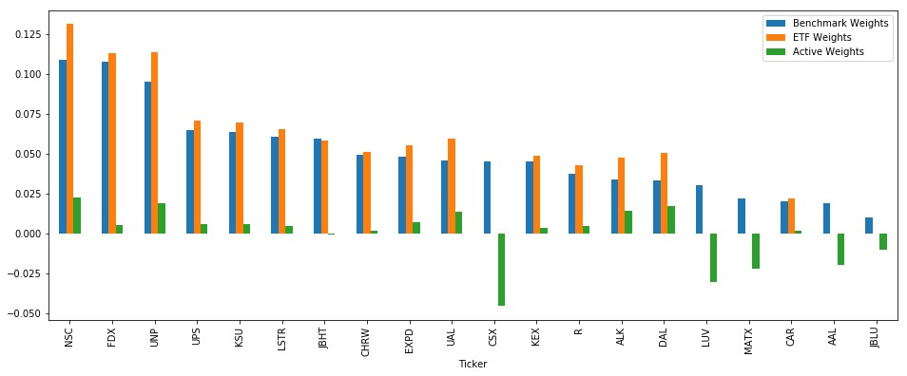
Static ETF Strategy
Tracking Errors (bps)
Model (# of stocks) | Train | Test
Base case EWMA (14) | 77.995 | 188.862
Base case MA (15) | 147.029 | 132.015
Trainset: 2008,12,31 - 2017,12,31
Test set: 2017,12,31 – 2018,12,31
Index
Transportation sector
20 Components
MA case
Top 7 weighting stocks included
Looping through 7 to 15 to get optimized TE in trainset
EWMA case
Same procedures as MA case

Slide 3
How we find best separation?
The Key Point here is:
The distribution of returns in each period is similar.
→Use KS Test to compare Return Distribution in Train/Test.
We set the training end on 2012,12,31 first, and add one year to trainset each time until 2017.
From all 6 possible separations:
Only the 2017 separation works at 5% Level.
5%Level

Slide 4
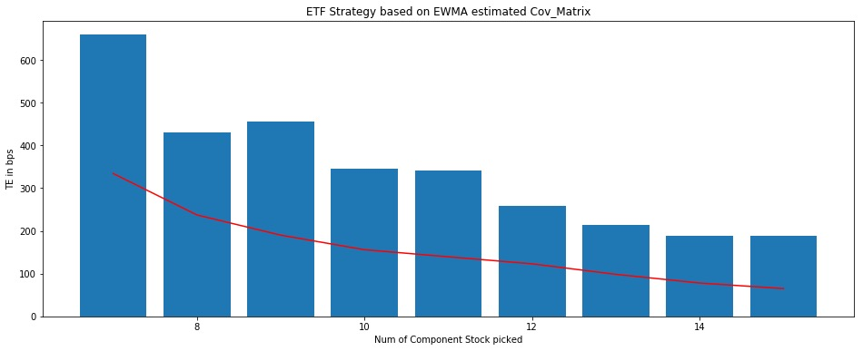
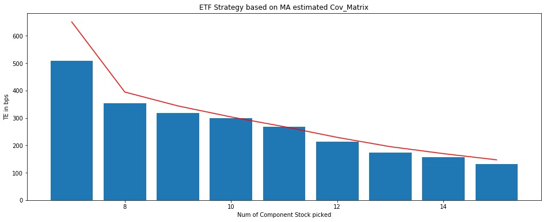
How many Components to Include?
Before Moving into Rolling:
The number of Stocks in ETF
More Stocks:
Possible Overfitting
Higher Cost of ETF
For the Chart:
In Test sets TE trending down as # of Stocks increased.
For EWMA:
Best TE achieve in both 14 and 15 Components
For MA case:
Best TE achieved in 15 Components
14 for EWMA:
Less overfit Prob.
Low cost
Similar TE
15 for MA:
Significant Lower TE

Slide 5
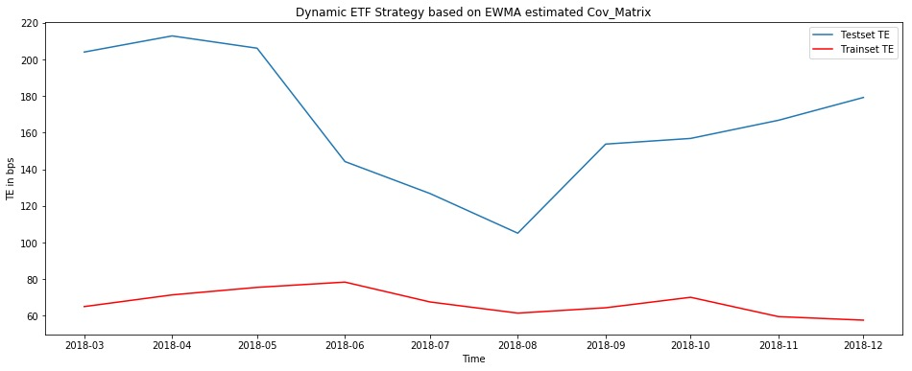
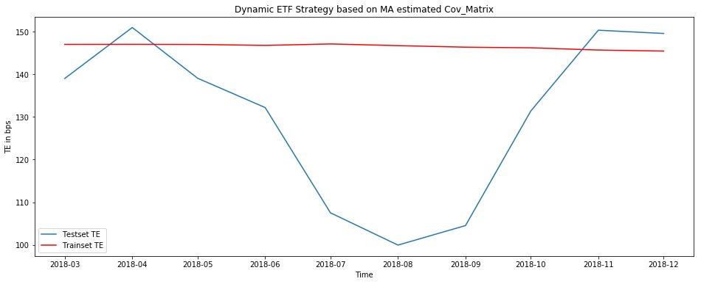
Dynamic ETF Strategy (Rolling Forward)
Monthly Rebalanced EFT Weights
TE Test Window 90 days
Rolling through all Test set:
2017,12,31 – 2018,12,31
Tracking Error relatively large.
Reason:
The Index has relatively small number of components
The Weights spreads evenly
The deleted 5 Components takes up almost 12% weights.

Slide 6
Index Explanation
Index | Explanation
AGG | iShares Barclays Aggregate Bond Fund
EEM | iShares MSCI Emerging Markets Index
GLD | SPDR Gold Trust
SUSA | iShares MSCI USA ESG Select ETF

Slide 7
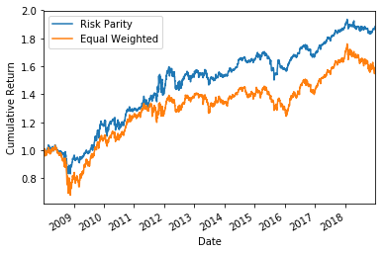
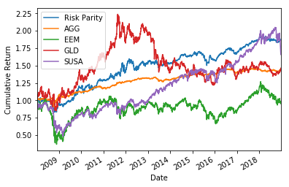
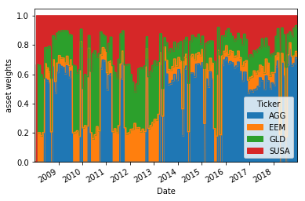
Part 2 Risk Parity Strategy-Unleveraged

Slide 8
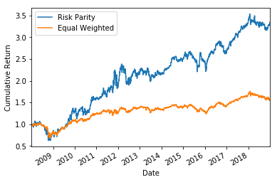
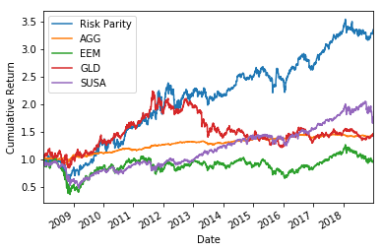
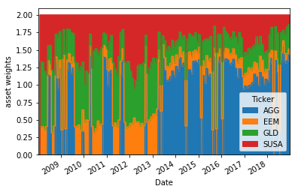
Part 2 Risk Parity Strategy-Leveraged

